Slide 1


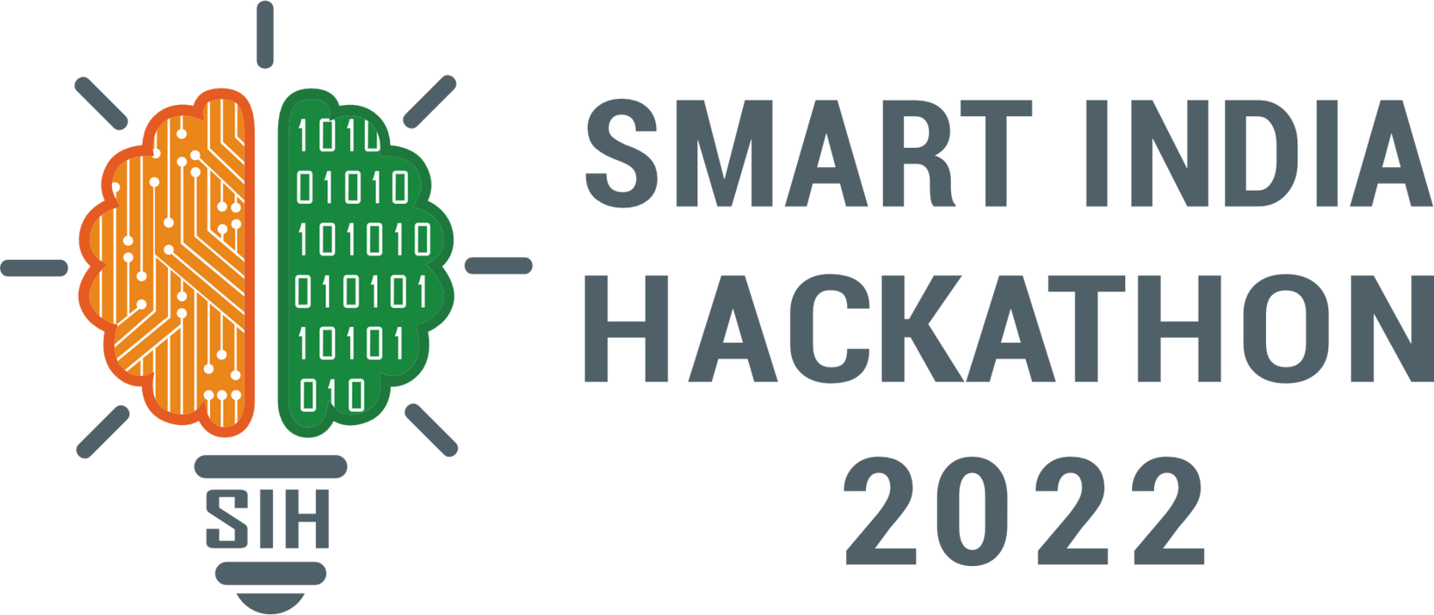
SMART INDIA HACKATHON 2025
TITLE PAGE
Problem Statement ID – SIH25022
Problem Statement Title - Maximizing Section Throughput
Using Al-Powered Precise Train Traffic Control
Theme - Transportation & Logistics
PS Category - Software
Team ID -
Team Name (Registered on portal) – Code Blooded

Slide 2



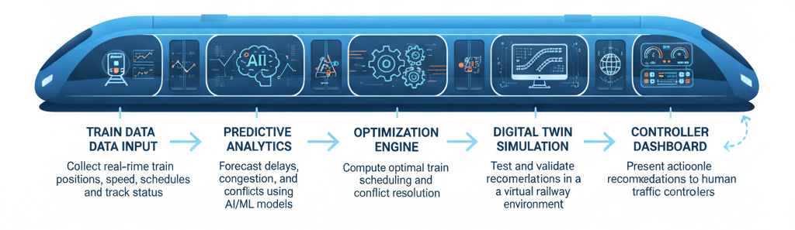
Red Dev
Redemption
Maximizing Section Throughput Using Al-Powered Precise Train Traffic Control
Proposed Solution
Innovation & Uniqueness:
Real-time monitoring of train positions, schedules, and track occupancy.
Predicts potential delays and congestion using AI/ML models.
Optimizes train movements using combinatorial optimization & reinforcement learning.
Simulates recommended actions in a digital twin before execution.
Provides actionable suggestions to traffic controllers via an intuitive dashboard.
Hybrid AI + Optimization: Combines ML predictions with scheduling algorithms.
Digital Twin Integration: Validates decisions in a safe, simulated environment.
Dynamic Prioritization: Balances train priorities (express, passenger, freight) in real-time.
Resource Efficiency: Maximizes section throughput using existing infrastructure.
Controller-Friendly: Supports human decision-making without replacing it.
AI-POWERED TRAIN TRAFFIC CONTROL SYSTEM: END TO END WORKFLOW

Slide 3







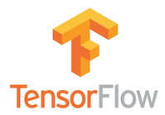






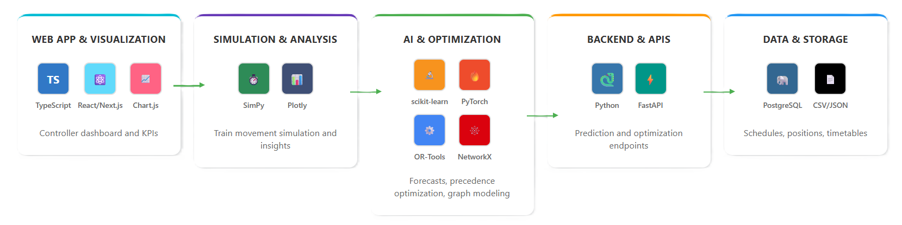
TECHNICAL APPROACH
Red Dev
Redemption
Technologies used:
Programming Languages: Python (AI, simulation, backend), JavaScript/TypeScript (frontend/dashboard)
AI & ML: Scikit-learn, TensorFlow/PyTorch (predictions & reinforcement learning), Prophet/ARIMA (delay forecasting), NetworkX (railway network modeling)
Optimization & Simulation: SimPy (train movement simulation), PuLP/OR-Tools (schedule optimization), DEAP (heuristic optimization), Matplotlib/Plotly (visualization)
Database & Data Handling: SQLite/PostgreSQL (store schedules & positions), CSV/JSON (prototyping)
Web & Dashboard: React/Next.js (dashboard), D3.js/Chart.js/Plotly (charts), FastAPI/Flask (API for predictions)
Real-Time Rail Control: The Technologies Used in each stage

Slide 4







FEASIBILITY AND VIABILITY
Red Dev
Redemption
Feasibility
AI, ML, and optimization algorithms are mature, well-documented, and open-source.
Railway scheduling and tracking APIs (like NTES) provide real-time train data.
Simulation frameworks (SimPy, Digital Twin) allow safe testing.
Supporting Facts for Feasibility & Viability
Indian Railways operates over 13,000 passenger trains daily, indicating huge optimization potential.
Delays cost both time and economic resources, highlighting the need for predictive systems.
AI adoption in transport is growing globally, with predictive traffic control showing 10–20% efficiency gains in studies.
Cloud-based digital twins are increasingly used in railways worldwide for safe and cost-effective simulations.
Viability
Increasing rail network congestion demand intelligent traffic control.
High adoption potential by railway authorities, private operators, and infrastructure boards.
Potential to improve punctuality, safety, and throughput across Indian Railways.
Challenges
Integrating predictive AI models with real-time train data streams.
Optimization algorithms may occasionally produce near-optimal solutions that need human validation.
Ensuring security and privacy of sensitive operational data.
Use Cases
Train Delay Prediction – Forecast delays and congestion before they happen.
Conflict Resolution – Optimize track allocation and train scheduling to avoid collisions.
Throughput Maximization – Increase the number of trains handled per section without compromising safety.
Controller Dashboard – Provide actionable insights, alerts, and visualization of real-time train movements.
Feedback Loop – Continuously improve predictions based on real-time data.
Solutions
Start with simulated datasets for POC and gradually integrate real-time train APIs.
Use hybrid AI + rule-based scheduling for higher accuracy and reliability.
Ensure role-based access and encryption to protect sensitive railway data.

Slide 5
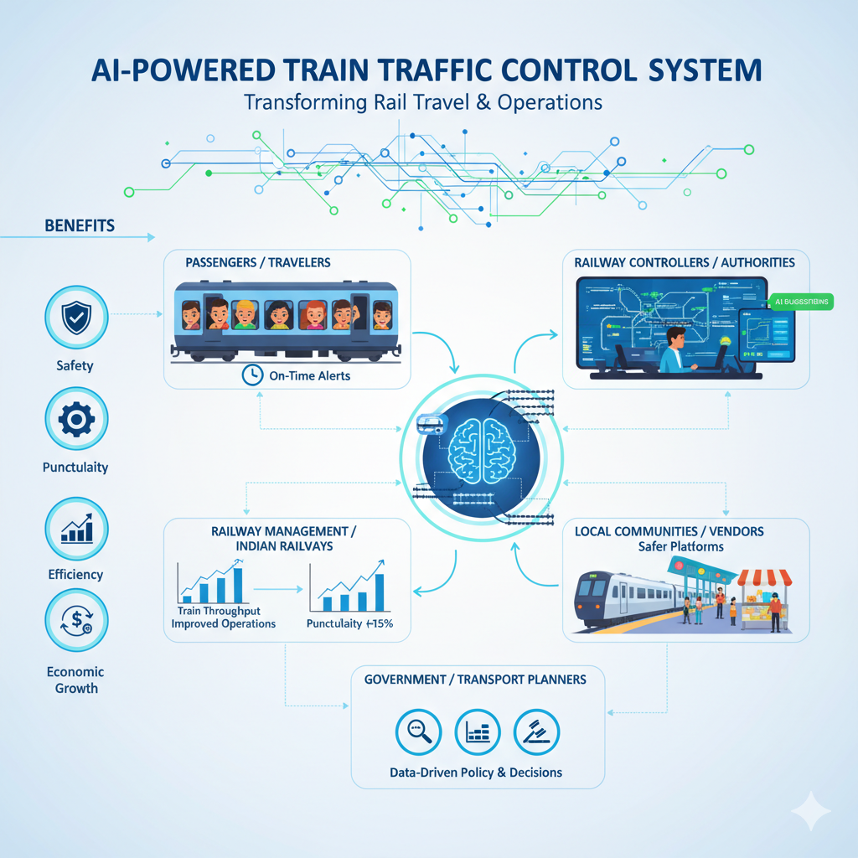

IMPACT AND BENEFITS
Red Dev
Redemption
Potential Impact on Target Audience
Passengers / Train Travelers: Safer and more reliable train journeys, fewer delays, proactive alerts during disruptions.
Railway Controllers & Authorities: Faster decision-making, optimized track usage, improved operational efficiency.
Railway Management / Indian Railways: Data-driven scheduling insights, higher punctuality, increased throughput of trains.
Government & Transport Planners: Better infrastructure utilization, actionable insights for policy and investment.
Benefits of the Solution
Social Benefit: Enhanced safety, punctuality, and comfort for passengers; reduces human errors in traffic control.
Economic Benefit: Improved train throughput reduces delays, boosting operational efficiency and passenger satisfaction.
Operational Benefit: Reduces manual workload for traffic controllers; AI assists in decision-making.
Reputational Benefit: Positions Indian Railways as a technologically advanced, smart, and efficient transportation system.
6

Slide 6


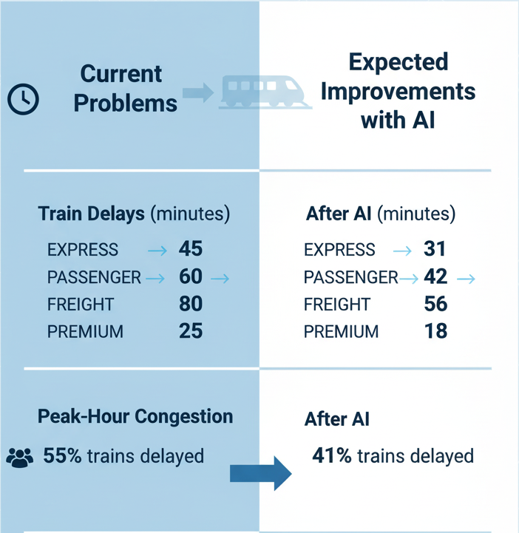

RESEARCH AND REFERENCES
Red Dev
Redemption
Code Blooded
References
Key Research Insights
Books
Hansen I. A., Pachl J. (eds.). Railway Timetabling and Operations: Analysis, Modelling, Optimisation, Simulation, Performance Evaluation. Eurailpress, 2014 -ch. 6, pp. 145–188, 17-18 Oct. 2025.
Patty B. W. (ed.). Handbook of Operations Research Applications at Railroads. Springer, International Series in Operations Research & Management Science, 2015 - ch. 12, pp. 301–348, 18-19 Oct 2025.
IEEE papers
Versluis N. D., Quaglietta E., Goverde R. M. P., Pellegrini P., Rodriguez J., “Real-time railway traffic management under moving-block signalling: A literature review and research agenda.” IEEE Transactions on Intelligent Transportation Systems, 2024.
Zhang Y., Luan X., Corman F., Li K., “Distributed optimization for real-time railway traffic management.” IEEE IFAC-Papers online, vol. 51, no. 9, pp. 337–342, 15-16, Oct. 2025
Articles
TRL (Transport Research Laboratory), “Options for capacity measures and metrics.” Office of Rail and Road (UK) Technical Report, 2014.
Sangphong O., Siridhara S., Ratanavaraha V., “Determining critical rail line blocks and minimum train headways for equal and unequal block lengths and various train speed scenarios.” Engineering Journal, vol. 21, no. 3, pp. 281–296, 15 Oct. 2025.

